Slide 1
Play It
Forward
CS 400
Created By: Megan Cole and Kory Kipperda
Toy selling, trading, and donating application.

Slide 2
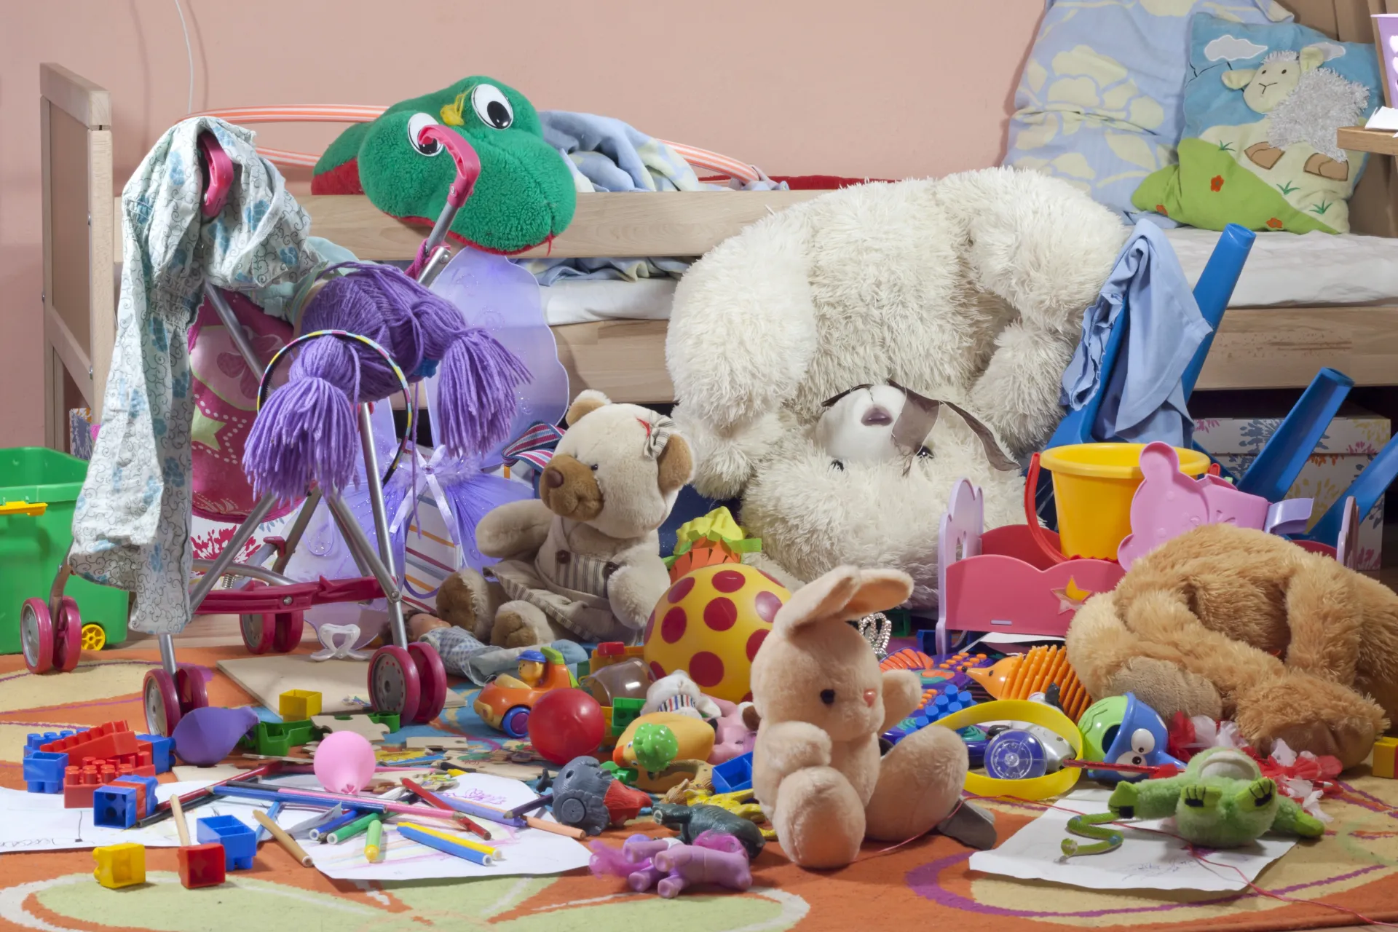
Too many toys?
Photo from: Kansas Children’s Discovery Center
Do you feel like your children have an abundance of unused toys are cluttering your house to the point you feel overwhelmed?

Slide 3
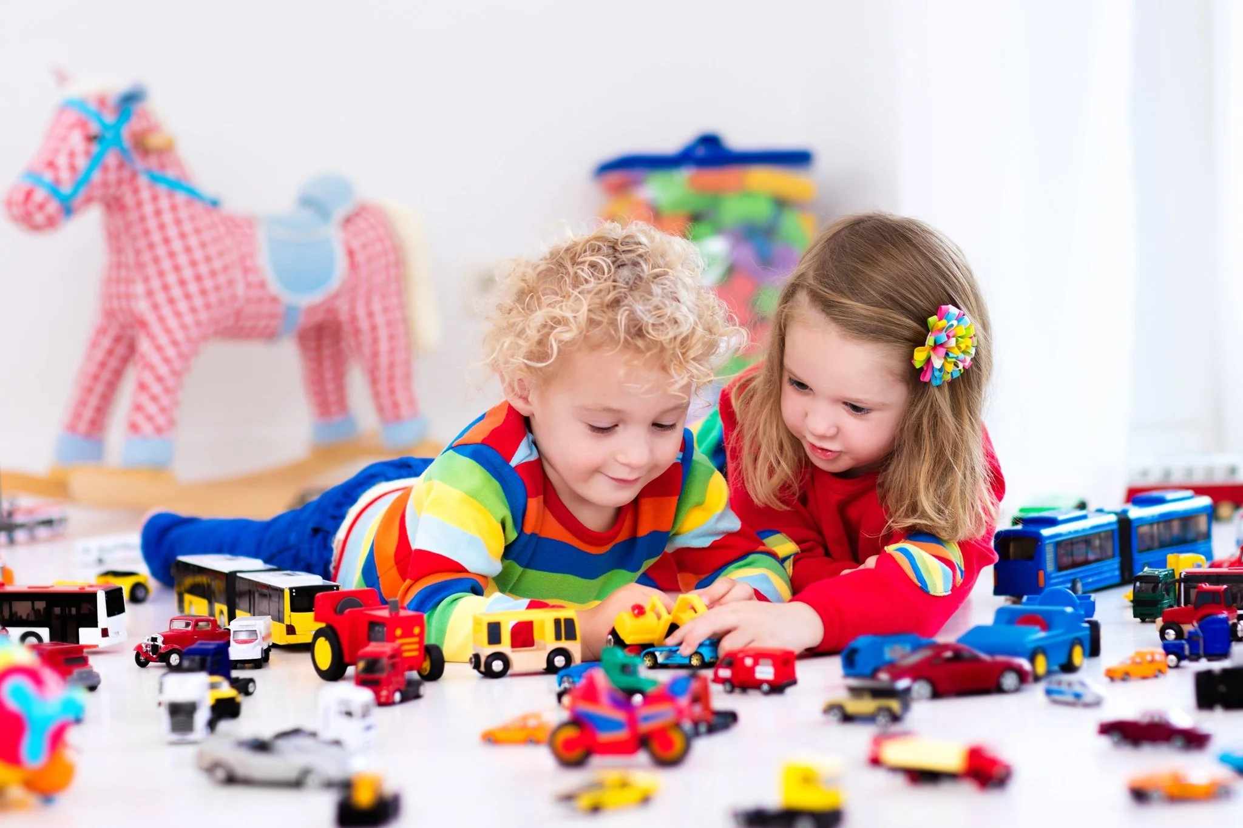
Looking for new toys?
Photo from: Nature’s Path
Is your family or organization looking for new toys to help bring joy, spark creativity, and create lifelong memories for children without breaking the bank?

Slide 4
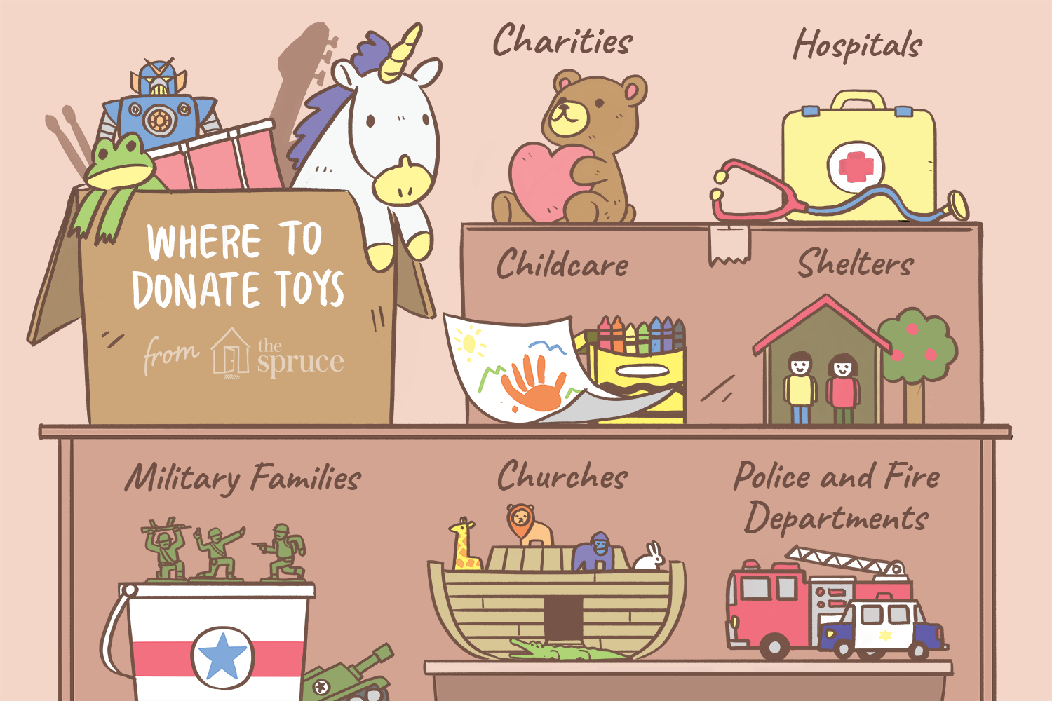
Not Sure Where to Start?
Photo from: Spruce
Knowing where to donate or shop in your local area can be challenging. Places like Facebook Marketplace are a great place to start but can also be difficult to find something specific for your child!

Slide 5
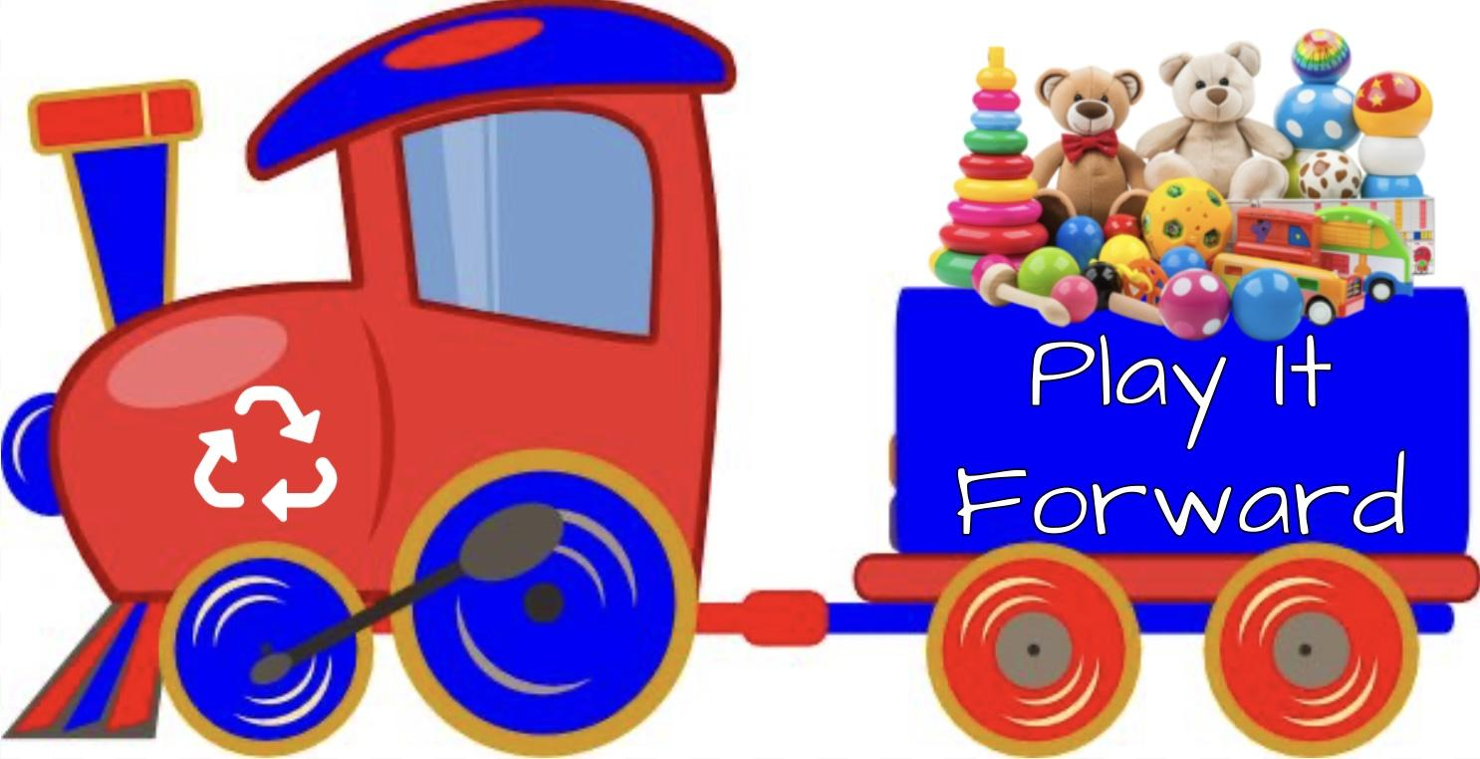
Let us help!
Introducing Play It Forward!
Sharing the Joy of Play, One Toy at a Time.

Slide 6

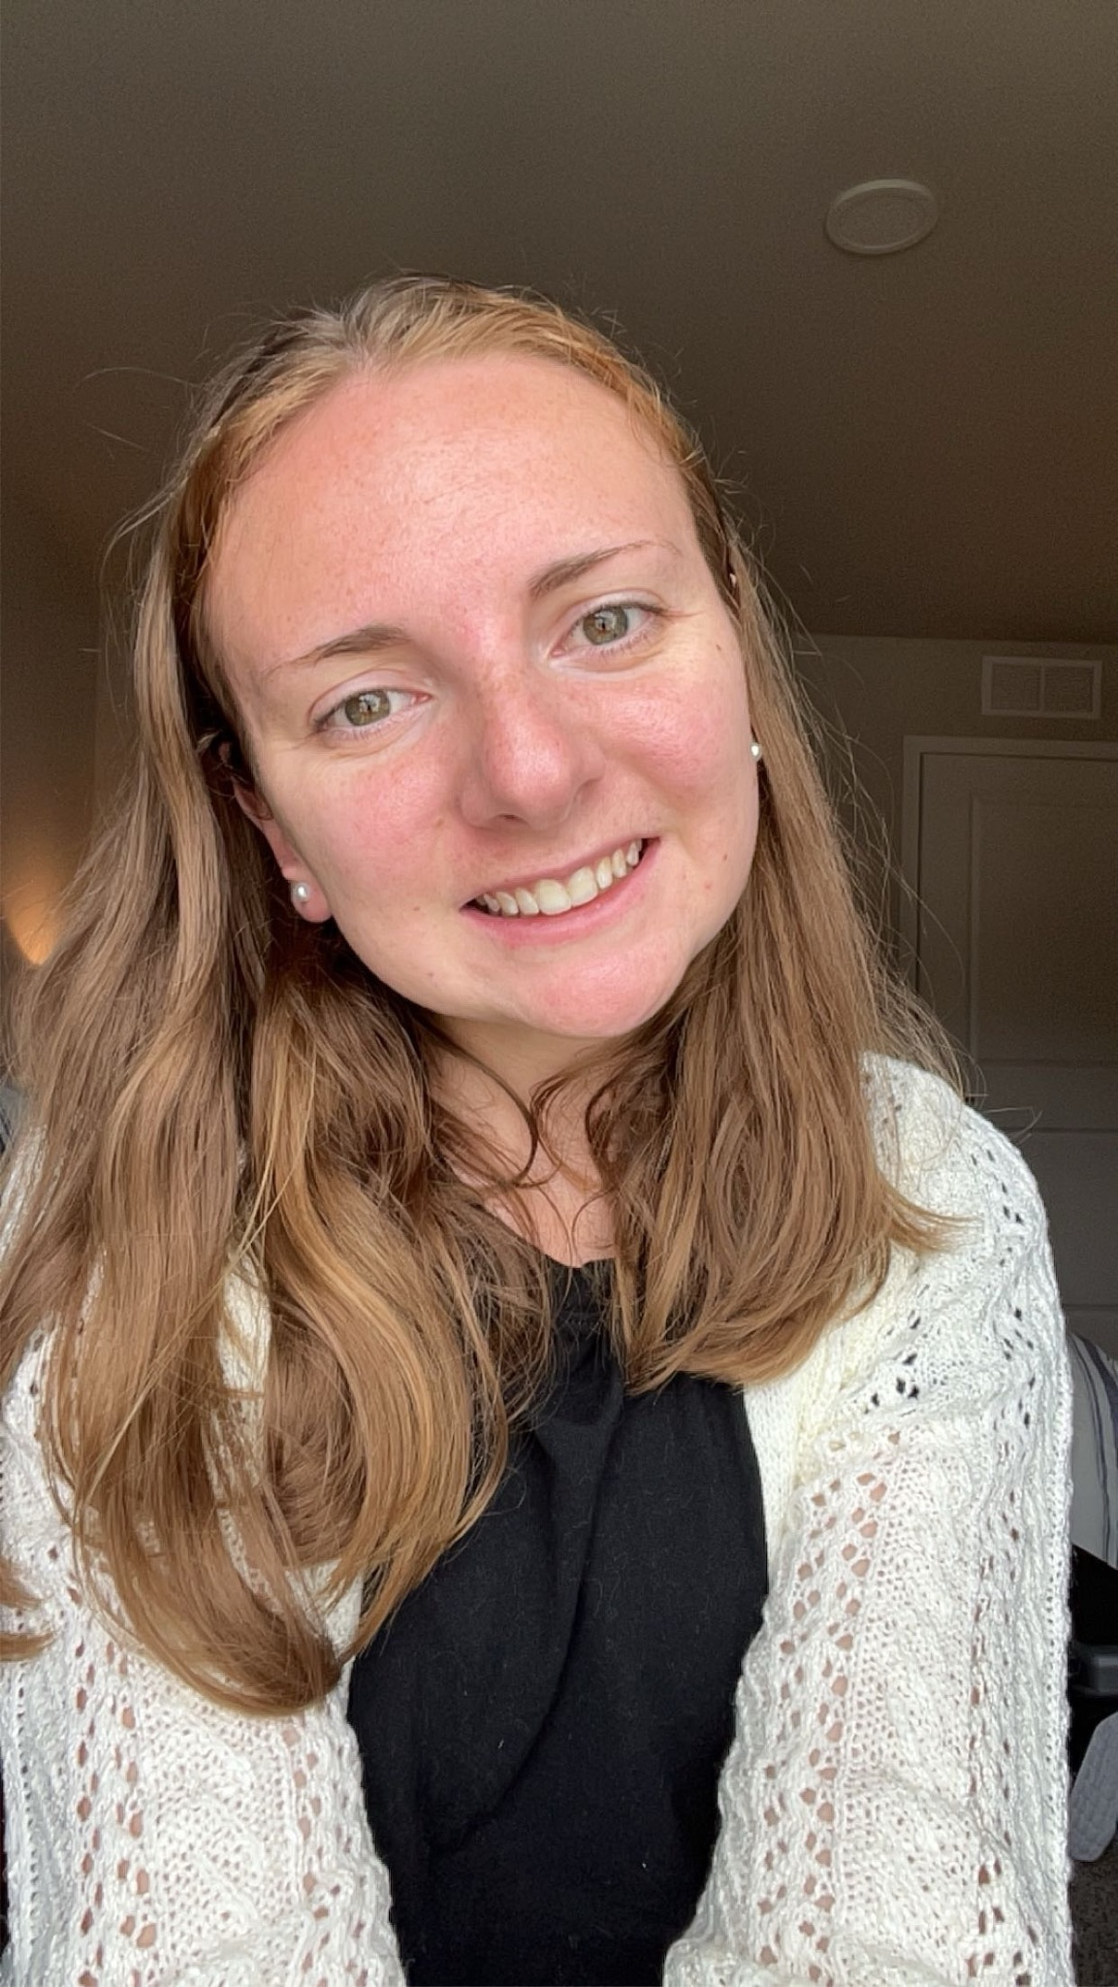
Who Are We?
Kory Ripperda
Father of 3, Intellectual Property Strategy Specialist, Software Engineering Student.
Our team combines our experience as a parent and teacher with our knowledge in software design to create a product that will suit your toy-finding needs. We are passionate about helping children have toys to play with to foster creativity, develop lifelong skills, and to have fun!
We hope that we can help you find children in your life quality toys that will create lifelong memories!
Megan Cole
Previous Elementary School Teacher, Quality Assurance (QA) Intern, Software Engineering Student.

Slide 7
Why Us?
Localized Search
Age-Specific Toy Listings
Donation Focus
You can find toys to donate, trade, or buy locally, fostering connections and supporting nearby families and organizations.
You can browse toys tailored to your desidered age group to ensure that toys are more relevant to your child.
We focus on donations and trades over sells to ensure that our main focus is on organizations and families in need.

Slide 8

Our Vision
Play It Forward is designed for parents, caregivers, and individuals looking to pass on or acquire gently used toys. The platform caters to people seeking educational toys for younger children and focuses on connecting them with toys that support cognitive and physical development. Non-profit organizations can also benefit by receiving toy donations or distributing toys to families in need, creating a bridge between individuals and those who require toys for children in their care.

Slide 9
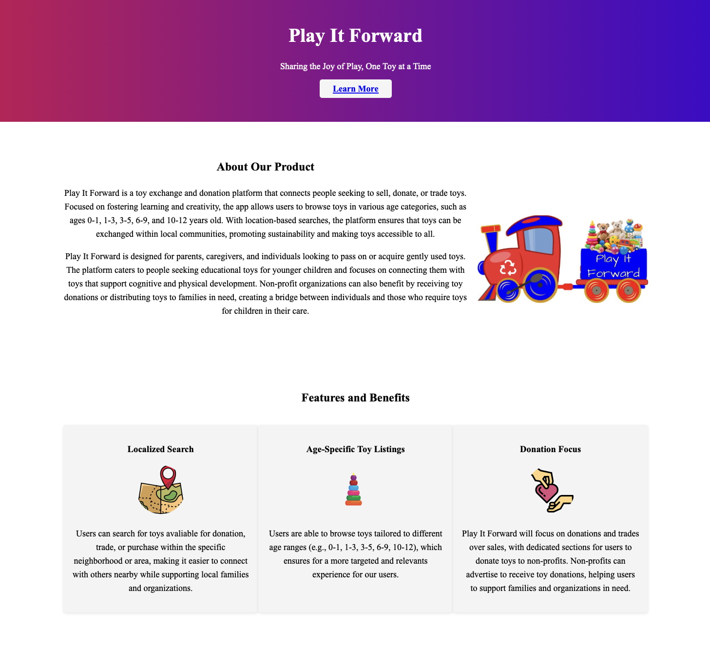

Check Out Our Landing Page to Learn More!

Slide 10
Photo Citations
Kansas Children's Discovery Center. "The Toy Monster: 10 Ways to Manage Too Many Toys." Kansas Discovery Center, https://kansasdiscovery.org/the-toy-monster-10-ways-to-manage-too-many-toys/. Accessed 14 Jan. 2025.
Nature's Path. "Taming Toy Clutter: Minimize Toys, Maximize Creativity for Kids." Nature's Path, 24 Dec. 2020, https://naturespath.com/blogs/posts/taming-toy-clutter-minimize-toys-maximize-creativity-kids. Accessed 14 Jan. 2025.
Sherman, Franchesca. "Where to Donate Toys." The Spruce, 19 May 2022, https://www.thespruce.com/where-you-can-donate-toys-3129154. Accessed 14 Jan. 2025.

